Slide 1
DTS207TC Database Development and Design
Lecture 7
Chap 11 Data Analysis
Di Zhang, Autumn 2025
Page titles with * will not be assessed

Slide 2
Outline
Data Warehouse
OLAP
Data Mining

Slide 4
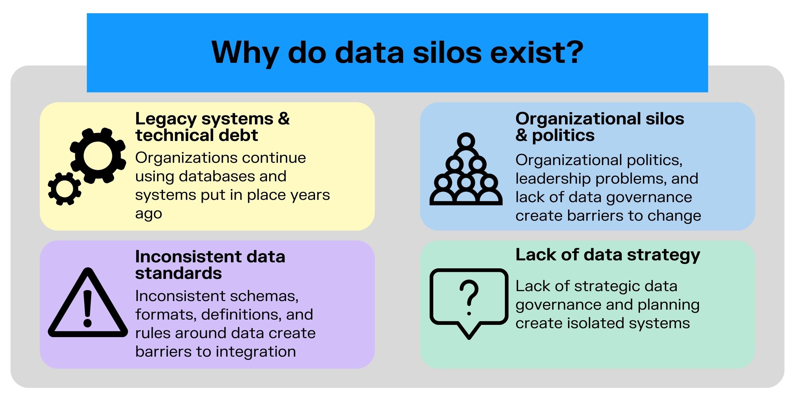

Slide 5
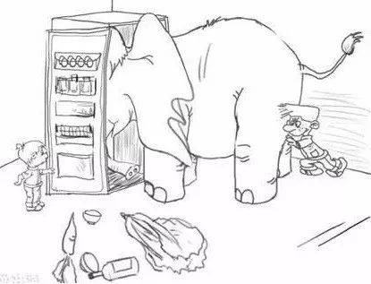
Analogy
We are trying to force the chaotic, concrete, and "opinion-filled" real world into an orderly, abstract, and "truth-seeking" model.

Slide 6
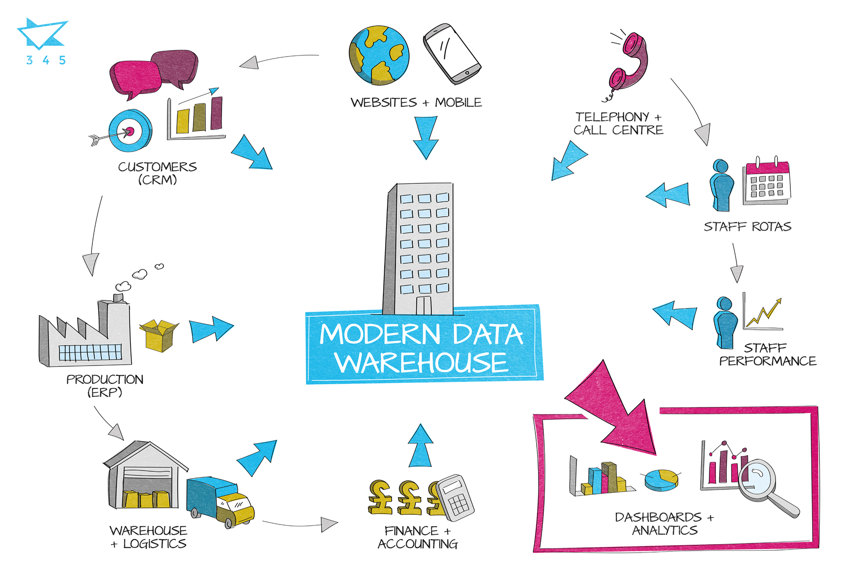
Core Concept: Separate data from its operational environment and build a subject-oriented, integrated, non-volatile, and time-varying data collection to support management decision-making.

Slide 7
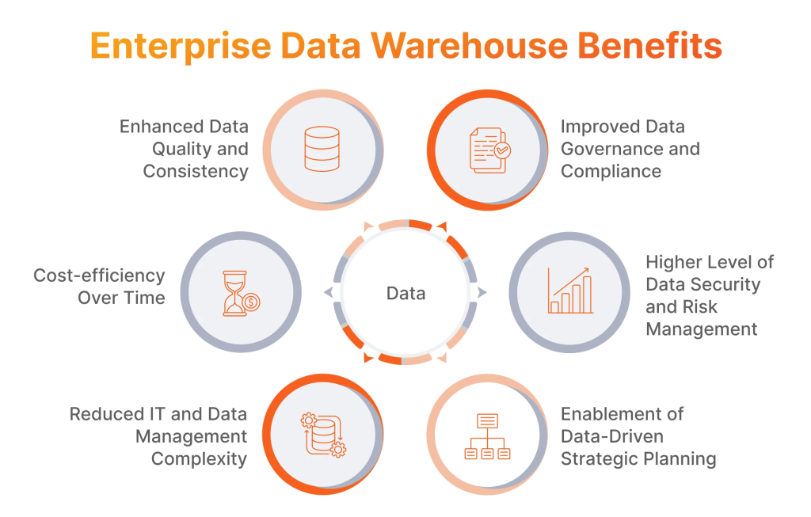

Slide 8
Data Warehouse vs. Operational Database
(OLAP vs. OLTP)
Characteristic | OLTP (Operational DB) | OLAP (Data Warehouse)
Purpose | Daily business operations | Support decision analysis
Users | Clerks, frontline staff | Analysts, managers
Data | Current, detailed | Historical, summarized
Operations | Frequent inserts, updates, deletes | Read-intensive (queries)
Model | Normalized (3NF) | Denormalized (Star/Snowflake)
Performance | Fast transaction processing | Fast complex query response

Slide 9
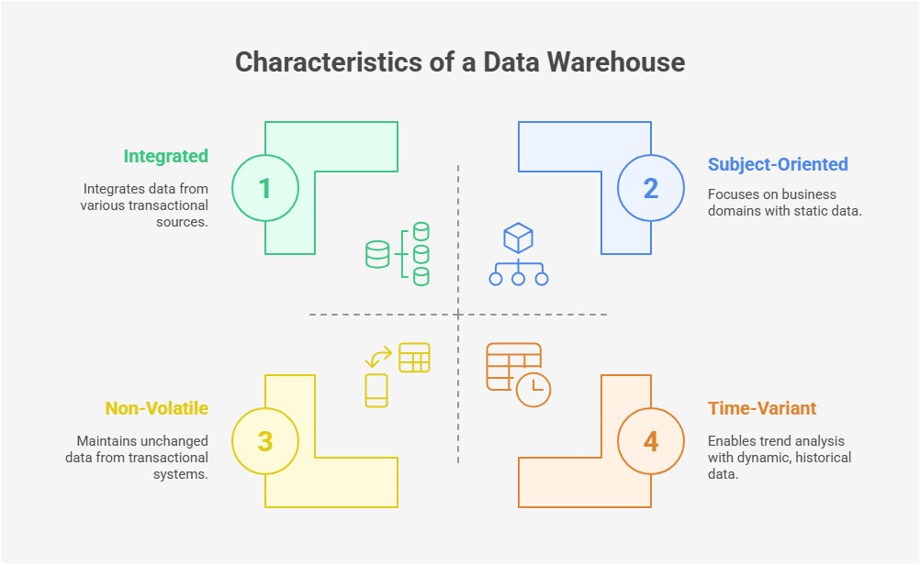
The Four Key Characteristics of a Data Warehouse

Slide 10
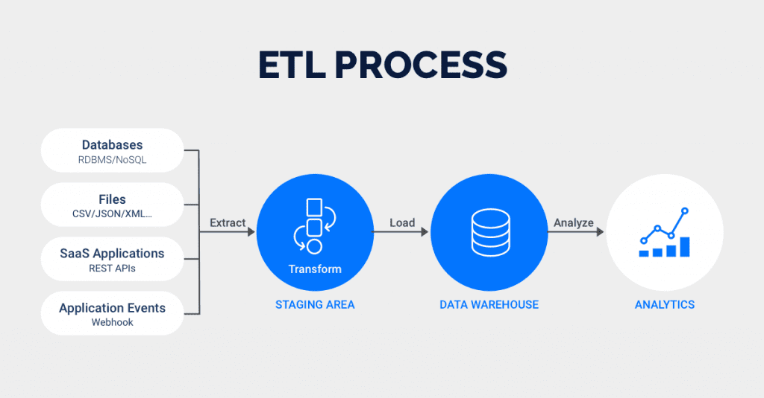
ETL: The "Mover" and "Beautician" of Data

Slide 11
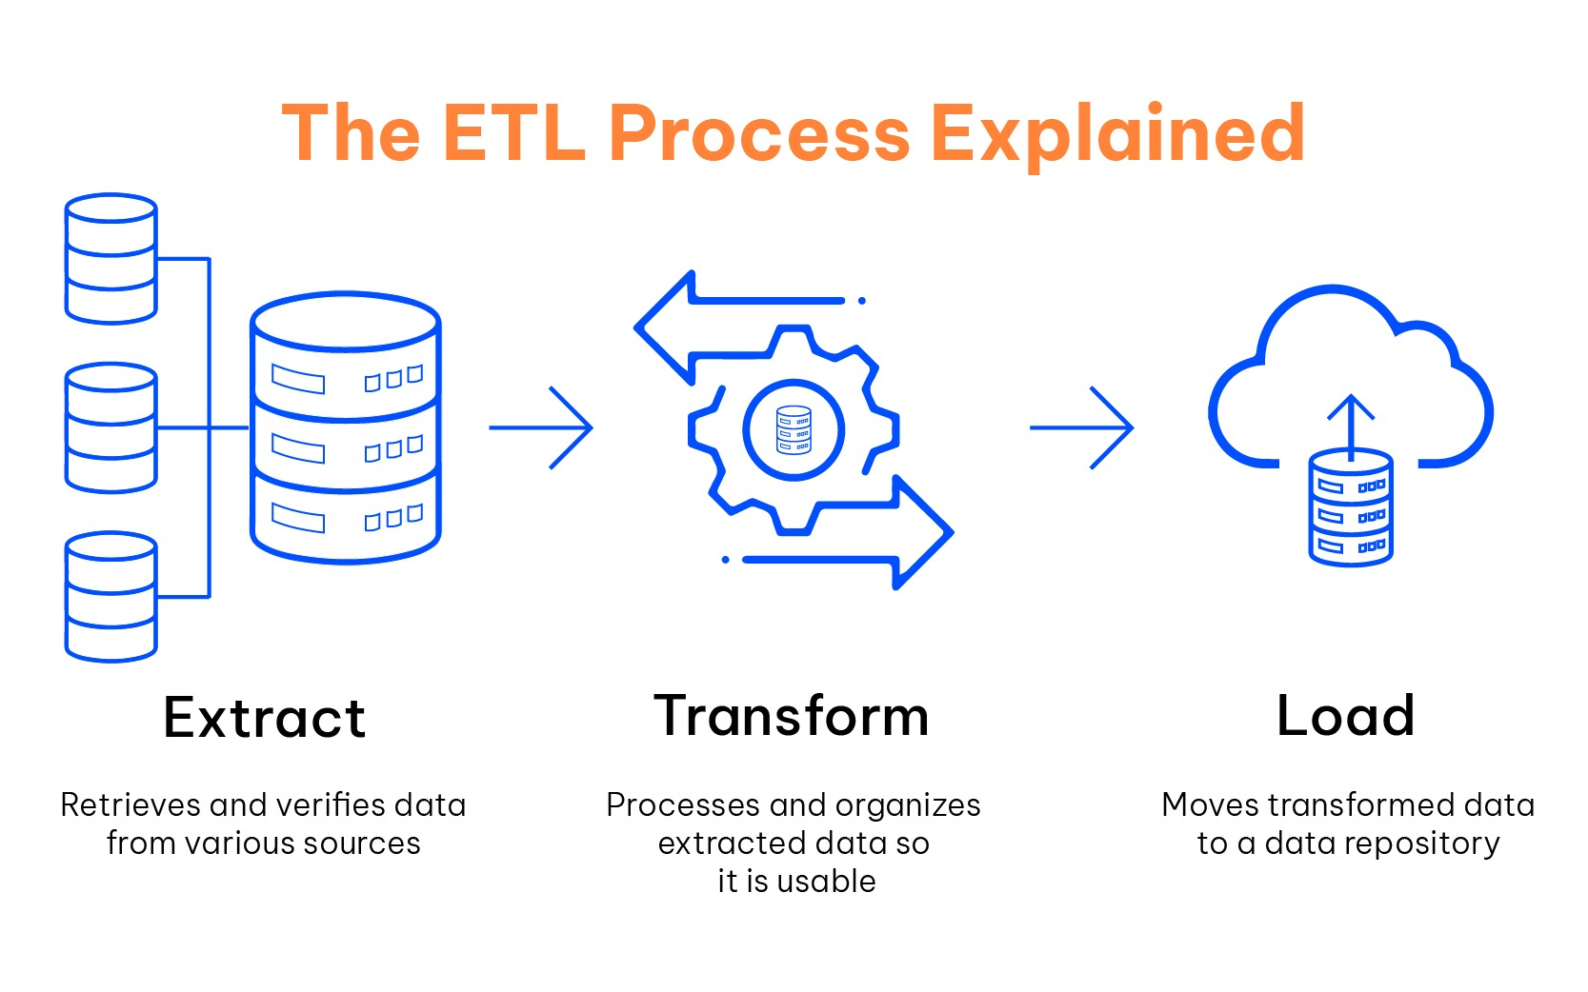

Slide 12

ETL Example

Slide 13
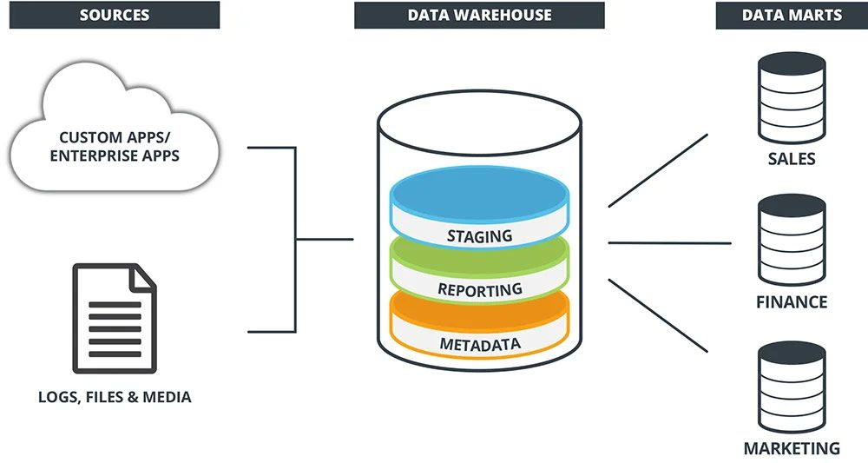
The Layered Architecture of a Data Warehouse

Slide 14
Staging Area
Function: Temporarily stores raw data extracted from source systems; where the 'T' in ETL happens.
Often physically separate from the core warehouse. Functionalities:
  Temporarily store data extracted from different data sources before transforming it and loading it into the destination system;
  Clean and normalise the data to eliminate duplicates, inconsistencies, missing or erroneous values, etc;
  Apply validation and quality rules to ensure that the data is complete, accurate and consistent;
  Apply transformations to change the format, structure and values of data to adapt them to the requirements of the destination system;
  Enable consistency and conformity checks on data before it is finally loaded into the destination system.

Slide 15
Core Data Warehouse
Function: Stores integrated, cleaned, transformed enterprise-wide historical data.
The model is relatively stable; it is the single source of truth.

Slide 16
Data Marts
Definition: A subset of the data warehouse, tailored for a specific department or business line (e.g., Sales Mart, Finance Mart).
Two Construction Approaches:
  Top-Down: Derived from the enterprise DW, ensuring consistency.
  Bottom-Up: Departmental data marts are built first, then integrated into an DW.

Slide 17
Motivation
Why Do We Need a Data Model?
  Improve query performance.
  Enhance data understandability.
  Provide a foundation for OLAP.

Slide 18
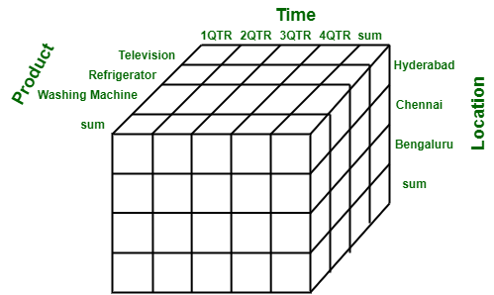
The Multi-Dimensional Data Model: Core Idea
Facts: The measures to be analyzed (e.g., Sales Amount, Quantity Sold).
Dimensions: The perspectives for analyzing facts (e.g., Time, Location, Product).
Analogy: Facts are "verbs," dimensions are "nouns."

Slide 19
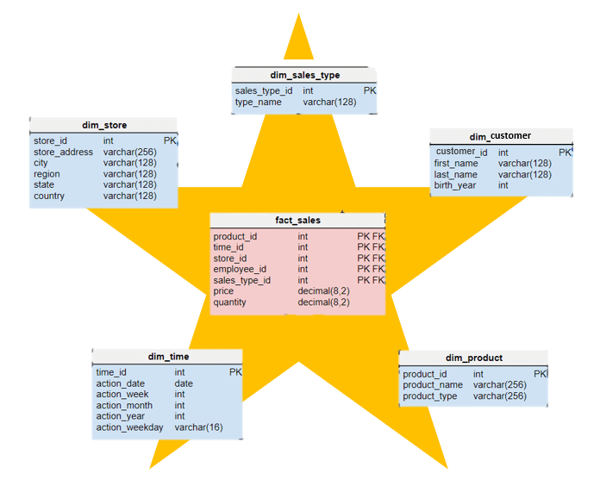
Star Schema
Diagram: One central fact table connected to multiple dimension tables.
Characteristics:
  Simple structure, easy to understand.
  High query performance (denormalized).
  The most common modeling approach.

Slide 20
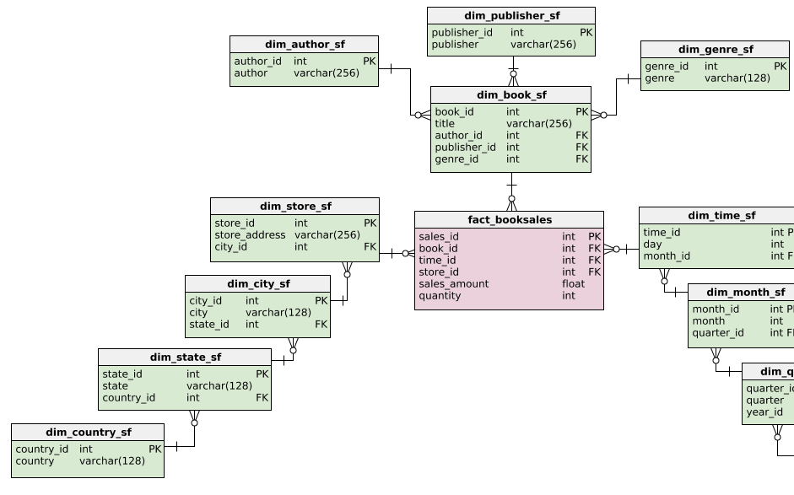
Snowflake Schema
Diagram: The dimension tables in a star schema are normalized, forming a hierarchy.
Characteristics:
  Saves storage space.
  Structure is more normalized.
  Queries can be slower due to more joins.

Slide 21
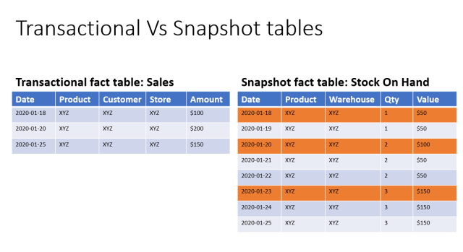
Fact Tables
Composition: Dimension Keys (Foreign Keys) + Measures (Facts).
Types:
  Transaction Fact Table: Records a specific event (e.g., a single sale).
  Periodic Snapshot Fact Table: Records a regular status (e.g., end-of-month account balance).
  Accumulating Snapshot Fact Table: Tracks a workflow process (e.g., order status flow).

Slide 22
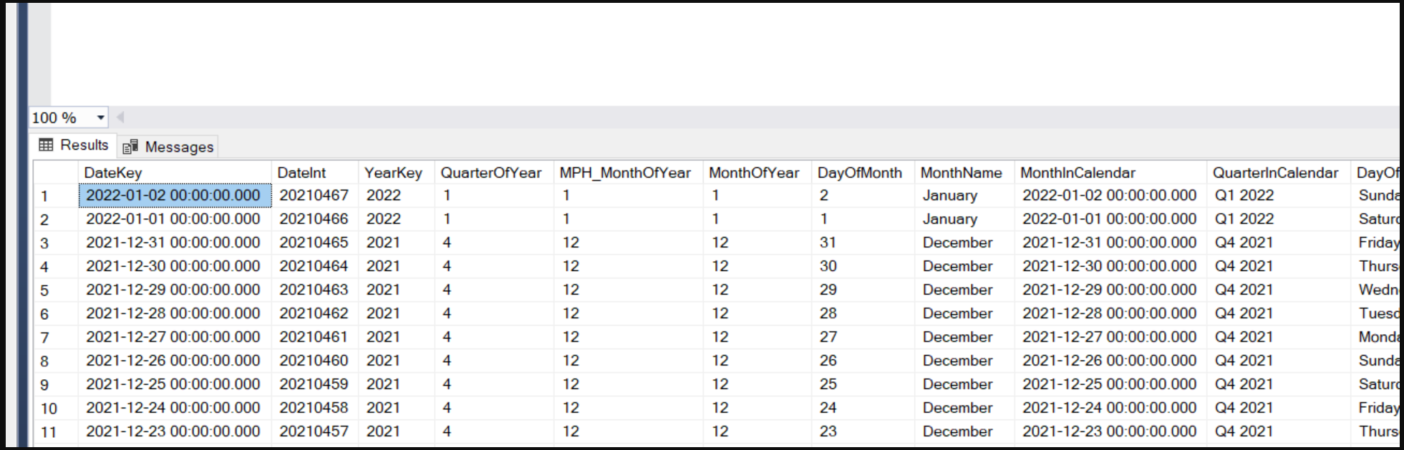
Dimension Tables
Composition: Surrogate Key (Primary Key) + Dimension Attributes (textual descriptive fields).
Characteristics: Contain rich descriptive information for filtering and grouping.

Slide 23
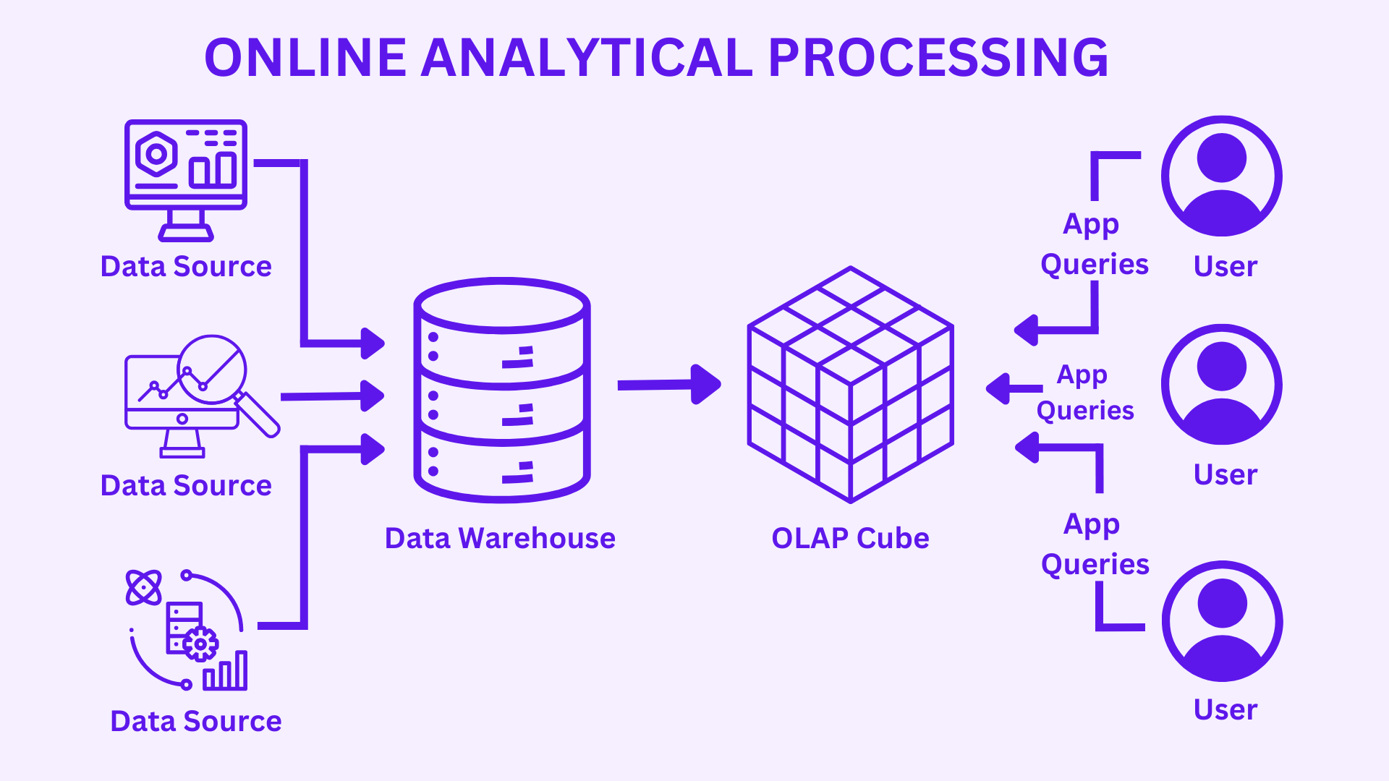
What is OLAP?
Definition: Online Analytical Processing. A technology that enables users to quickly, consistently, and interactively access data from multiple perspectives.
Goal: Support complex analysis and decision-making.

Slide 24
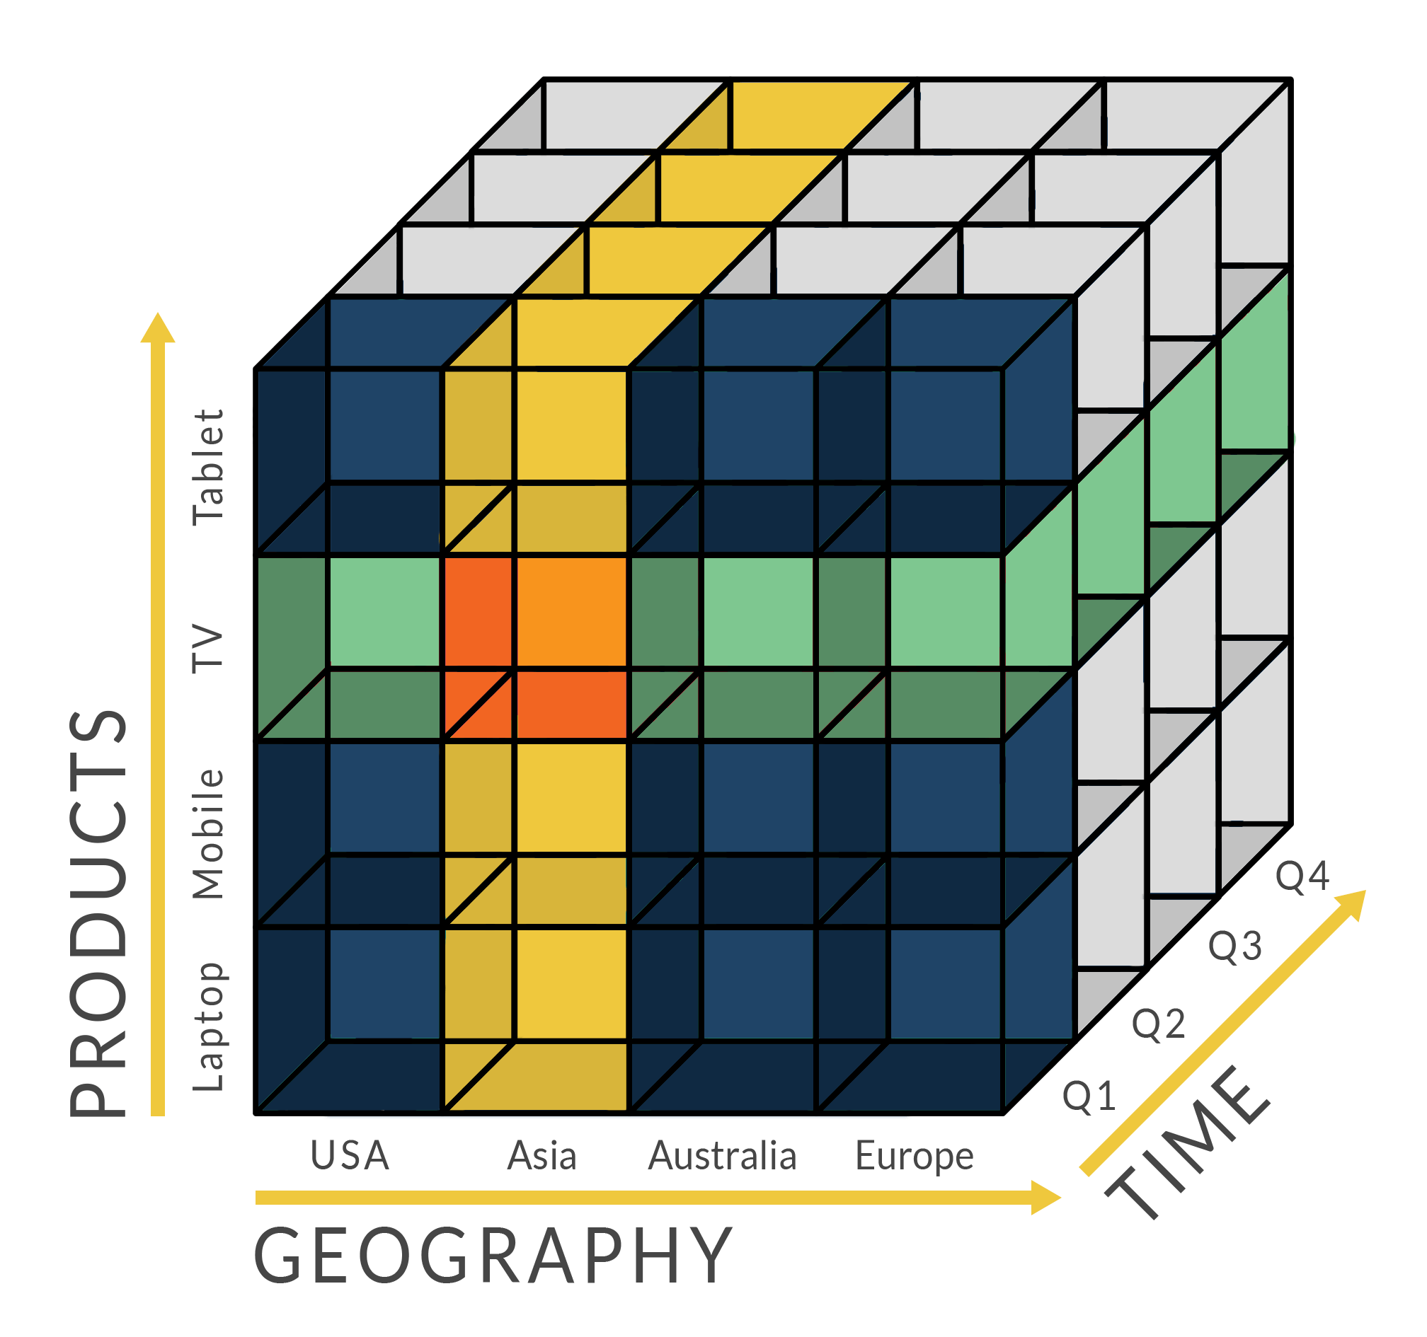
Core Concept: The Cube
Diagram: A 3D data cube (Product, Time, Region -> Sales Amount).
Explanation: The physical or logical implementation of the multi-dimensional model; the foundation for OLAP operations.

Slide 25
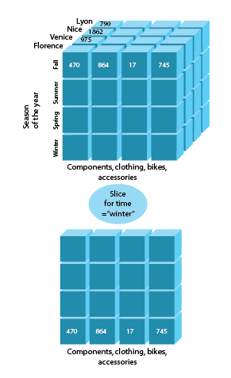

Core OLAP Operation: Slice
Definition: Selecting a value on one dimension of the cube.
Example: Selecting data for "Time = January 2023".
1
Notes:
https://galaktika-soft.com/blog/olap-operations-in-data-mining.html

Slide 26
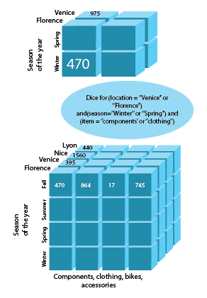
Core OLAP Operation: Dice
Definition: Selecting a range of values on one dimension.
Example: Selecting data for "Time in Q1 2023".
https://www.budgetbytes.com/how-to-slice-dice-and-mince/

Slide 27
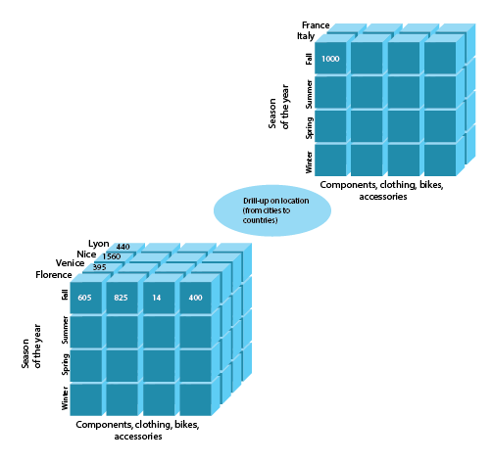
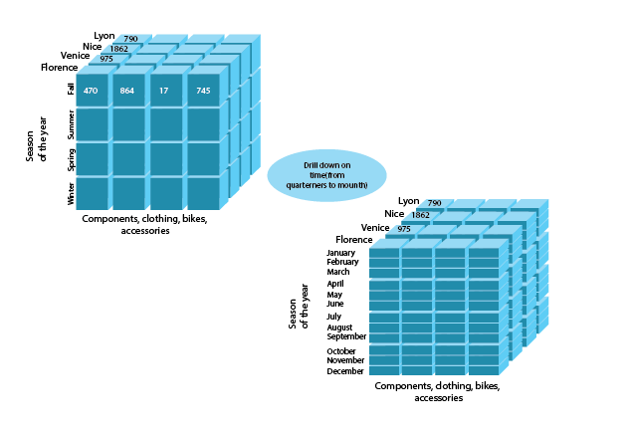
Core OLAP Operation: Drill
Drill-Down: Moving from summarized data to more detailed data (e.g., from "Year" to "Quarter" to "Month").
Roll-Up: The inverse of drill-down, aggregating detail data to a higher level.

Slide 28
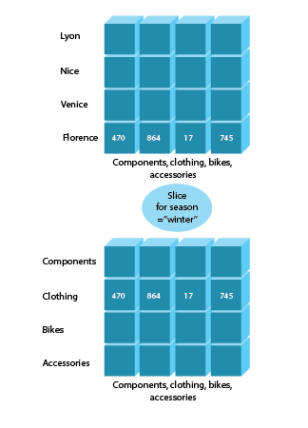
Core OLAP Operation: Pivot (Rotate)
Definition: Swapping the row and column dimensions to provide a different view of the data.
Example: Swapping "Product" on rows with "Region" on columns.

Slide 29
Cross-Tab: 2D Representation of Multi-Dimensional Data
Diagram: A standard pivot table / crosstab.
  Rows: Product Category
  Columns: Year
  Intersection: Sales Amount
Explanation: This is the most intuitive representation of OLAP operation results.

Slide 30
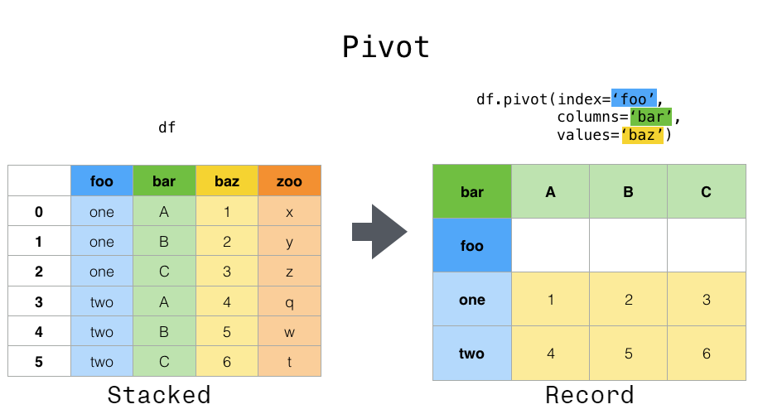
From Cube to Cross-Tab
Visual Flow: 3D Data Cube -> Via Slice/Pivot Operations -> 2D Cross-Tab.
Emphasis: The cross-tab is the output of OLAP analysis.

Slide 31
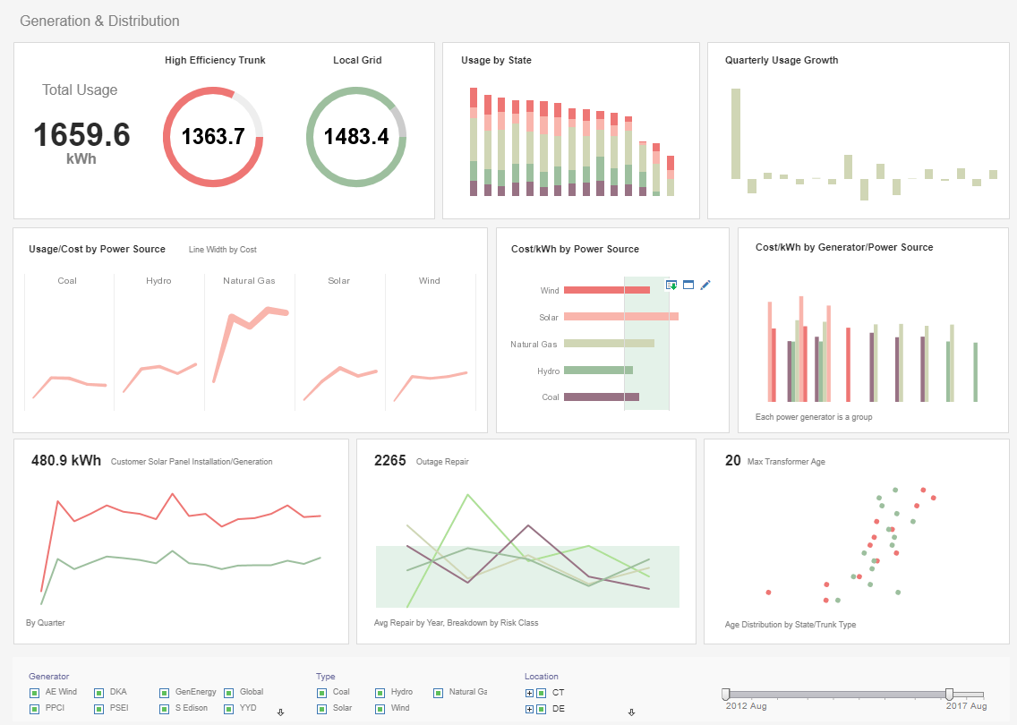
Reporting Systems: Solidified Insights
Definition: Generate fixed-format reports (daily, weekly, monthly) regularly based on the data warehouse.
Characteristics: Standardized, automated.

Slide 32

Common Chart Types
Trend Analysis: Line Chart
  Comparison Analysis: Column Chart, Bar Chart
  Composition Analysis: Pie Chart, Stacked Column Chart
Distribution Analysis: Scatter Plot, Histogram
  Relationship Analysis: Heat Map
  Geospatial Analysis: Map

Slide 33
Overview: A three-coordinate system (you can define your own)
Algorithm | X: Model Complexity | Y: Regularization Strength | Z: Ensemble Method | Positioning Description
Linear Regression | Low (near origin) | None (near origin) | None (near origin) | The simplest baseline model, located in the (low, low, low) corner of the coordinate system.
Ridge Regression | Low | High (+Y) | None | Builds upon linear regression by adding L2 regularization, moving it in the +Y direction.
Lasso Regression | Low | High (+Y) | None | Similar to Ridge, but uses L1 regularization (which also performs feature selection). Also located in the +Y direction.
Decision Tree | Medium-High (+X) | Low (can be increased via pruning) | None | A single tree is a flexible model with higher complexity than linear models, placing it in the +X direction.
Support Vector Regression (SVR) | Medium (depends on kernel) | Medium (controlled by parameter C) | None | Its core idea of maximizing the margin is a form of regularization, placing it in the medium region of both X and Y.
K-Nearest Neighbors (KNN) | Medium (controlled by K) | Low | None | Complexity is determined by the number of neighbors K. Low K means high complexity (+X), high K means low complexity. Typically has no explicit regularization.
Random Forest | High (each tree is complex) | Medium (Bagging acts as regularization) | High (+Z) | Integrates multiple decision trees via Bagging. It possesses high complexity (+X) and strong ensemble characteristics (+Z). The Bagging process also reduces variance, providing a regularization effect (+Y).
Gradient Boosting Machine (GBM) | High | High (via learning rate/tree depth) | High (+Z) | Integrates multiple weak learners (typically trees) sequentially via Boosting. It employs strong regularization (+Y) by limiting tree depth, using a learning rate, etc., and is a powerful ensemble method (+Z).
Neural Network | Very High (Far +X) | Adjustable (Dropout, L2, etc.) | None (typically) | Possesses extremely high expressive power. Techniques like Dropout and weight decay can move it in the +Y direction to prevent overfitting given its complex structure.

Slide 34
Data Mining
We will review this in the lab next week (Data Warehouse for this Week)
Cheatsheet of ML

